Slide 1
hand-written Digit recognition using neural network

Slide 2
Contents:
Introduction
Objective
Framework
Neural Network Model
Conclusion
References

Slide 3
INTRODUCTION
This prototype system can detect handwritten digits from a scanned image (as input form) by using Neural network technique.
In other words, to let the computer understand the digits that is written manually by users and views them according to the computer process. Here, we present a way to recognize isolated digits exist in different forms.

Slide 4
OBJECTIVES
There are many fields concern with numbers, for example, checks in banks or recognizing numbers in car plates, the subject of digit recognition appears.
The main objective for our system was to recognize digits exist in different application.
For example, different users have their own handwriting styles where here the main challenge falls to let computer system understand these different handwriting styles and recognize them as standard writing.

Slide 5
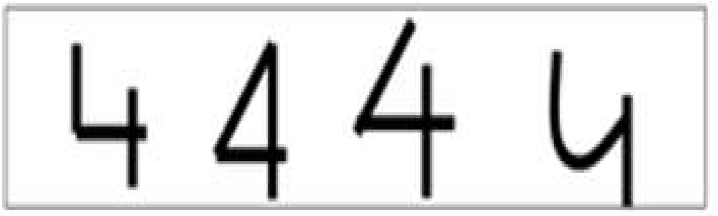
THIS Figure shows some examples of different user handwritten DIGIT(4)

Slide 6
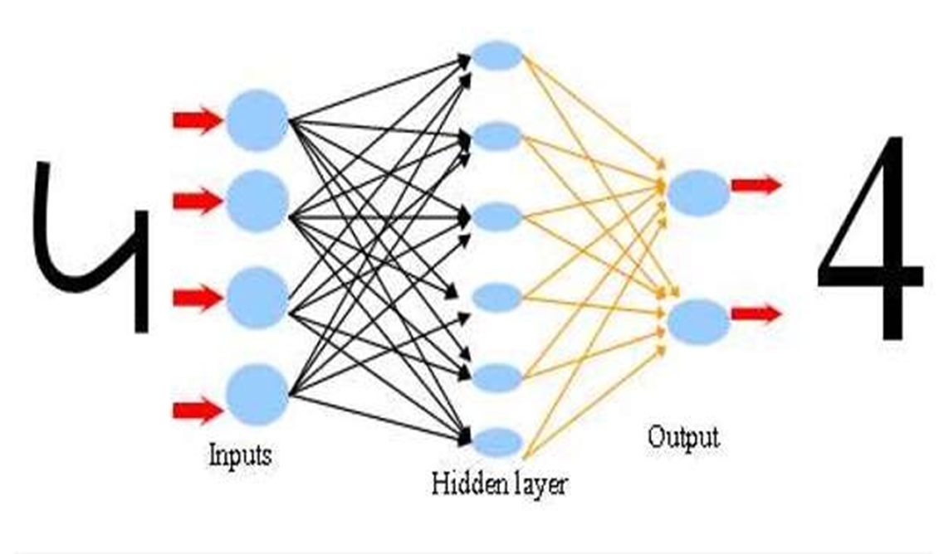
the scenario of number recognition with Artificial Neural Network which contains input and hiding layer and output with the number (4) for examination the Network.

Slide 7
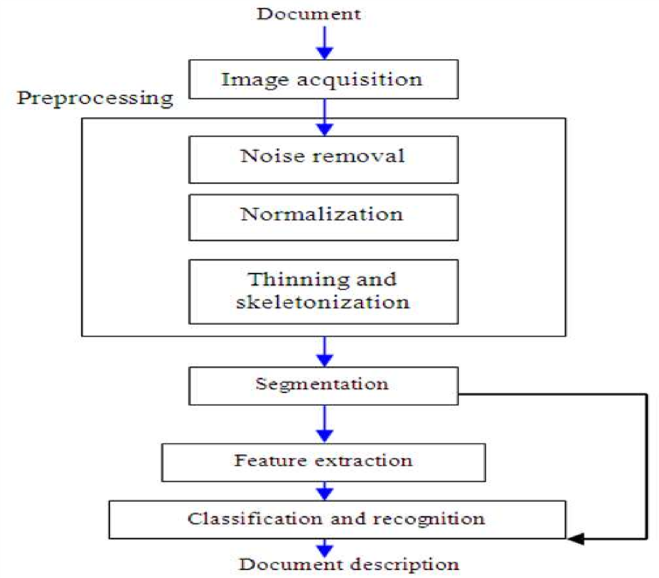
FRAMEWORK

Slide 8
STEPS
Image acquisition:
We will acquire an image to our system as an input .this image should have a specific format, for example, bmp format and with a determined size such as 30´20 pixels. This image can be acquired through the scanner or, digital camera
Pre-processing:
After acquiring the image, it will be processed through sequence of pre-processing steps to be ready for the next step.
Noise removal: Reducing noise in an image. For on-line there is no noise to eliminate so no need for the noise removal. In off-line mode, the noise may come from the writing style or from the optical device captures the image.

Slide 9
Normalization-scaling: Standardize the font size within the image. This problem appears clearly in handwritten text, because the font size is not restricted when using handwriting.
Thinning and skeletonization:
Representing the shape of the object in a relatively smaller number of pixels. Thinning algorithms can be parallel or sequential.
Parallel is applied on all pixels simultaneously.
Sequential examine pixels and transform them depending on the preceding processed results.
Segmentation:
Since the data are isolated, no need for segmentation. With regards to the isolated digits, to apply vertical segmentation on the image containing more than digit will isolate each digit alone.

Slide 10
Classification and recognition:
Neural Network is a network of non-linear system that may be characterized according to a particular network topology. Where, this topology is determined by the characteristics of the neurons and the learning methodology. The most popular architecture Of Neural Networks used in Arabic digits recognition takes a network with three layers. These are: Input layer, hidden layer and output layer.
Digit Recognition use Approaches:
In case of Neural Network we actually use two types of models.
Two Layer Network Model
Three Layer Network Model
Here we use the Three Layer Network Model

Slide 11
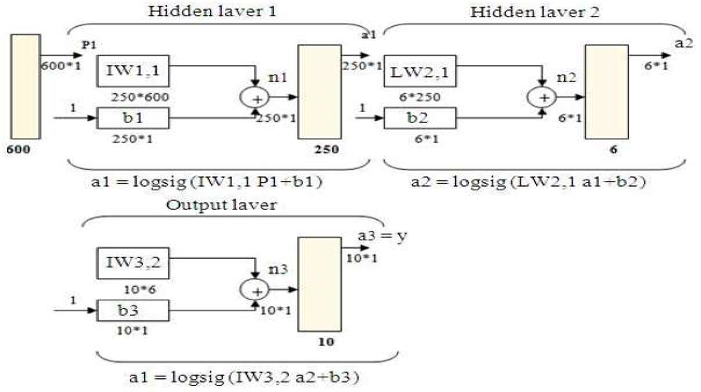
Three layers network, two hidden and one output, with 250,6,10 neurons respectively for each layer

Slide 12
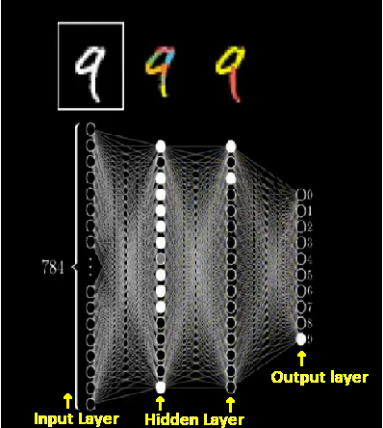
Three Layers of artificial neural network

Slide 13
Conclusion:
We can conclude that we reached the computer to the human’s brain by the importance use of isolated digits recognition for different applications.
This recognition starts with acquiring the image to be pre-processed throw a number of steps.
As an important point, classification and recognition have to be done to gain a numeral text. In a final conclusion, neural network seems to be better than other techniques used for recognition.

Slide 14
References:
Tzanakou, E.M., 2000. Classifiers: An Overview , from Supervised and Unsupervised Pattern Recognition: Feature Extraction and Computational Intelligence. CRC Press LLC.,ISBN: 0-8493-2278-2, pp: 371.
Khorsheed , M.S., 2002. Off-line Arabic character recognition-a review. http://cat.inist.fr/?aModele=afficheN&cpsidt=13683853
Saleh Ali K. Al-Omari, Putra Sumariv, Sadik A. Al-Taweel and Anas J.A. Husain, “Digital Recognition using Neural Network”, Journal of Computer Science 5 (6): 427-434, 2009 ISSN 1549-3636

Slide 15
Thank You

